Slide 1
COMMERCIAL VIABILITY
MED-GOLD LIVING-LAB 2021
JUNE 7TH

Slide 2
Living Lab 2021 Experts panels
COMMERCIAL VIABILITY
What are we going to see/do ?
Why a plan?
Business Models Methodologies
Examples (Business Cases)
Prototype
Wrap-up & final words

Slide 3
Business Context

Slide 4
Why a plan?
It’s better to have a BAD plan…

Slide 5
Why a plan?
… than nothing

Slide 6
What THE goal?
GOAL
ADDED VALUE
PRODUCT / SERVICE
PERCEIVED VALUE
clients

Slide 7
Business definition workflow
Idea
Business Plan
Building Product / Service
Beta
Launch to market
“Traditional” BUSINESS PROCESS

Slide 8
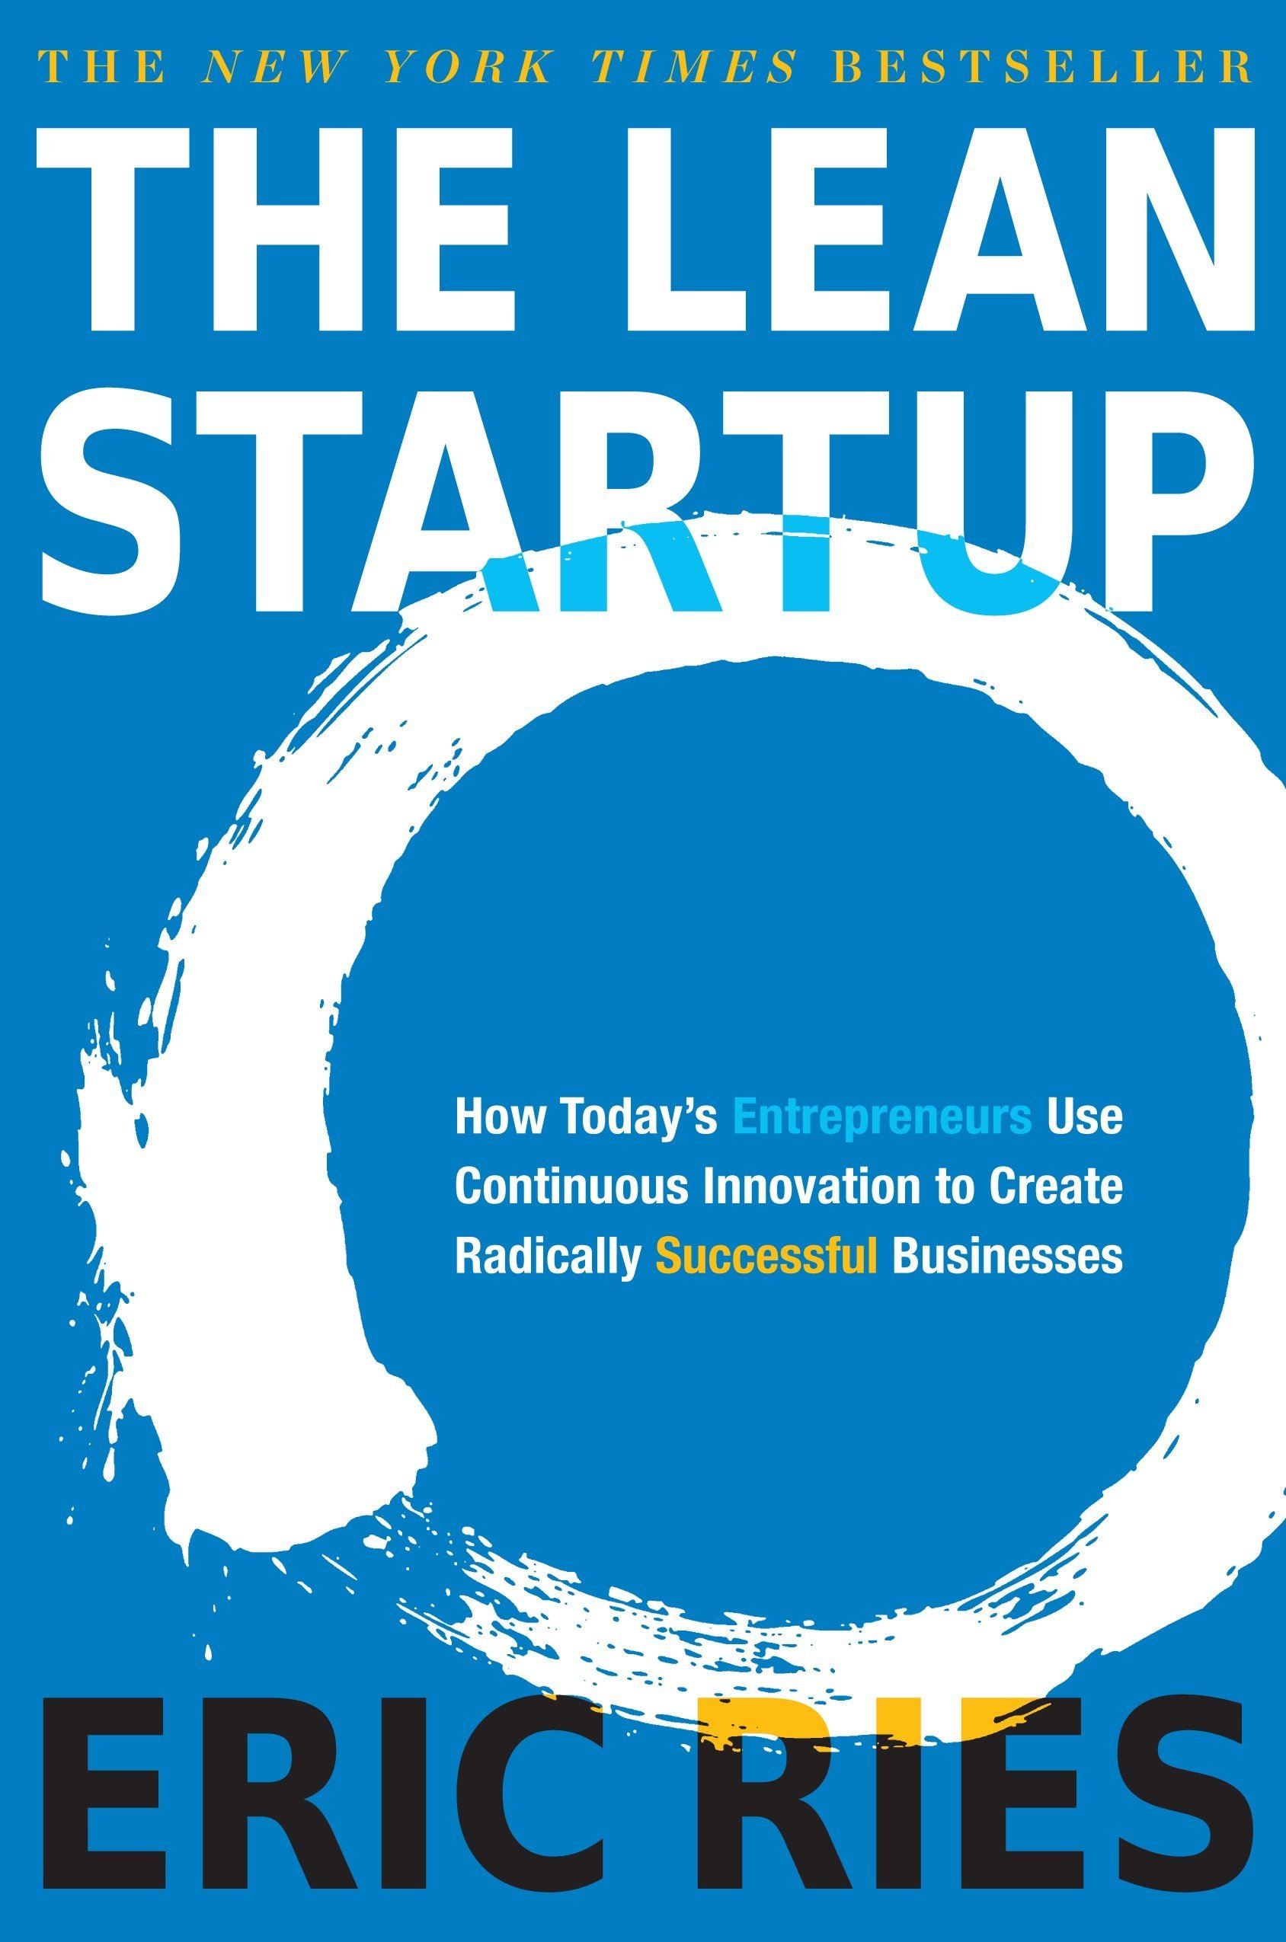
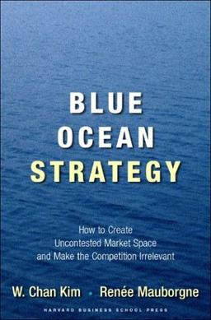

Slide 9
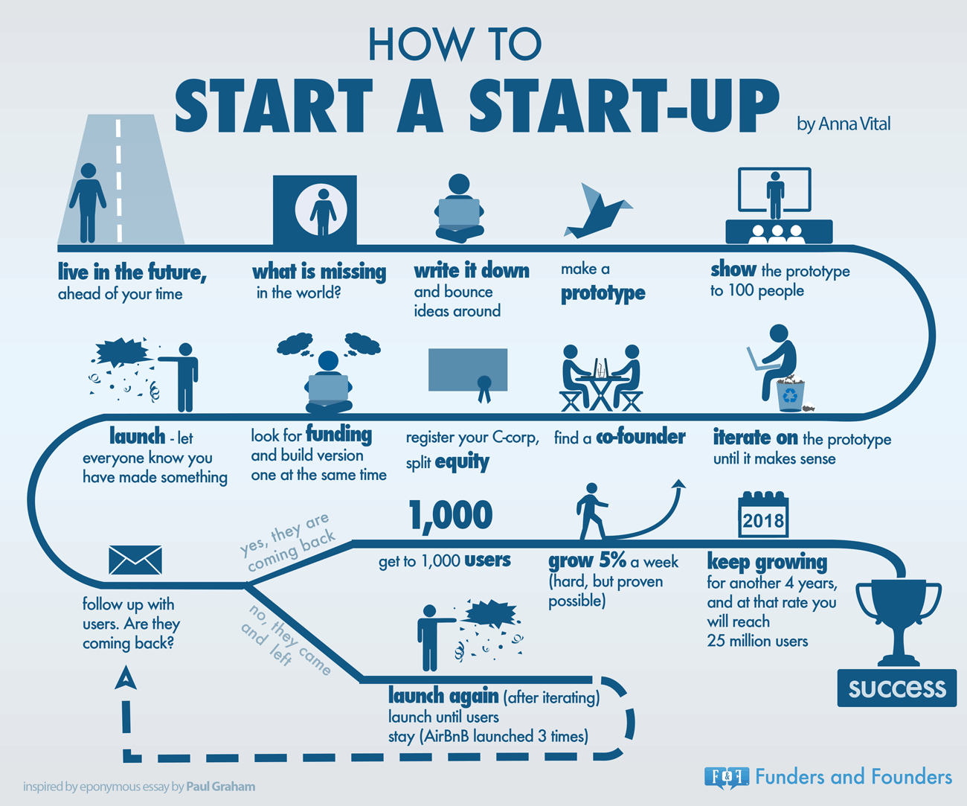
Partnership-WIN-WIN approach:
Find the entry point (champion user)
Identify and fill the gap (research/innovation)
Create your story line/successful story (prototype)
Strengthen the partner/Ownership
DONE!!
$
EU/other project partners
Potentialities to be scaled-up
Sell innovation (EU/Private Sector/…)
Scale-up (country/farming system adaptation)
Your Service is ready

Slide 10
Business Models Methodologies

Slide 11
BUSINESS MODEL
“DESCRIBES THE RATIONALE OF HOW AN ORGANIZATION CREATES, DELIVERS AND CAPTURES VALUE”
Alexander Osterwalder

Slide 12
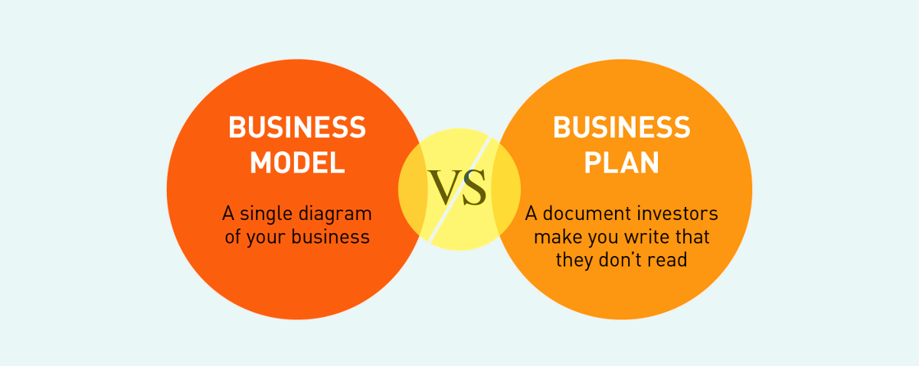
Don’t confuse!

Slide 13
BUSINESS MODEL CANVAS

Slide 14
Business canvas model
Key Partners Who are our key partner? Who are our suppliers? What key resources are we acquiring from partners? What key activities do partners perform? | Key Activities What key activities do our value propositions require? Our distribution channels? Customer relationships? Revenue streams | Value Propositions What value do we deliver to the costumer? Which one of our customer’s problem are we helping to solve? What bundies of products and services are we offering to each customer segments? Which customer needs are we satisfying? |  | Customer Relationships What type of relationship does each our customer segments expect us to stablish and maintain with them? Which ones have we stablished? How are they integrated with the rest of our business model? How costly are they? | Customer Segments For whom are we creating value? Who are our most important costumer?
 | Key Resources What key resources do our value propositions require? Our distribution Channels? Customer relationship? Revenue streams? |  |  | Channels Through which channels do our costumer segments want to be reached? How are we reaching them now? How are our channels integrated? Which ones work best? Which ones are most-efficient? How are we integrating them with customer routines?
Cost Structure What are the most important costs inherent in our business model? Which key resources are most expensive? Which key activities are most expensive? |  |  | Revenue Streams For what value are our customers really willing to pay? For what do they currently pay? How are they currently paying? How would they prefer to pay? How much does each revenue stream contribute to overall revenues?
http://www.businessmodelgeneration.com

Slide 15
LEAN CANVAS

Slide 16
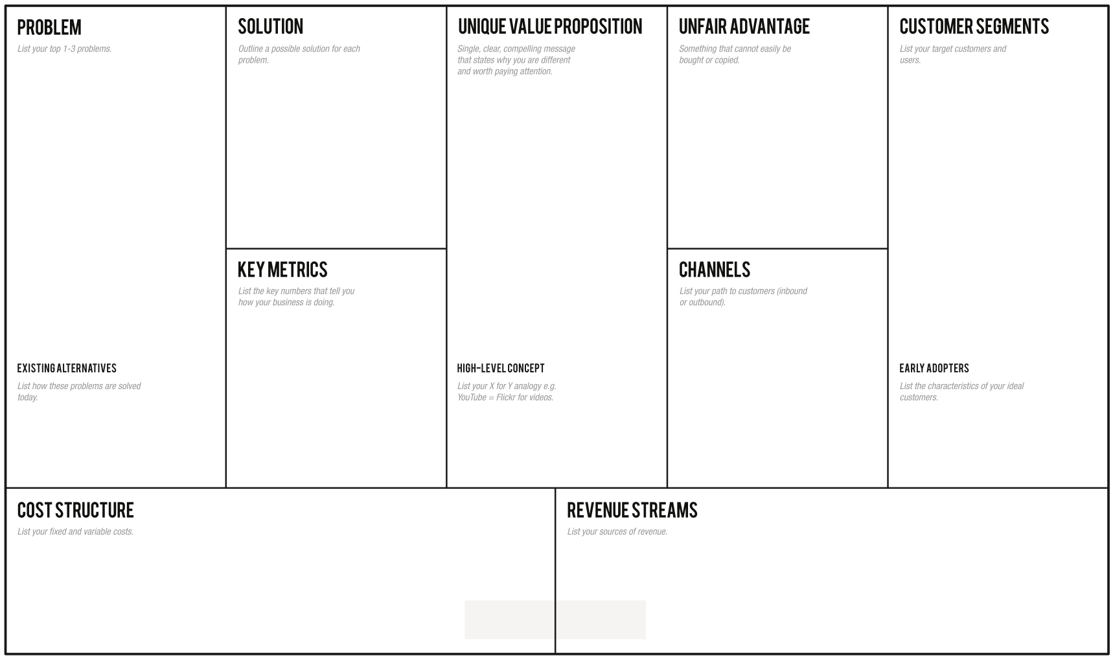
Lean Canvas model

Slide 17
What is your value proposition?

Slide 18
Acting without thinking
is like shooting without aiming…
B.C Forbes

Slide 19
Examples: MEDGOLD – Use Cases

Slide 20
MEDGOLD
Sectorial needs
Grape/wine/Olive
/oil Wheat/pasta
Collected from open platform/hub
In situ records collected by Sectorial Industrial partners
MED-GOLD ICT
MED-GOLD
Customers
climate data
Procces using models
MED-GOLD
Climate indexes, phenology information and disease indexes

Slide 21
MEDGOLD
PUBLIC Institutions
Private Institutions
Extension services
Cooperatives
Agribusiness Institutions/ Cooperatives like
Subscription (fee)
Free/nominal fee
Smallholder Farmers
Emerging Farmers
Banks, Insurance
Commercial Farmers

Slide 22
MEDGOLDBusiness canvas model
Key Partners CLIMATE DATA PROVIDERS LOCAL DATA PROVIDERS SECTORIAL PARTNER: OLIVE/OIL GRAPE/WINE WHEAT/PASTA COFFEE) HIGH TECH INSTITUES RESEACRH INSTITUTES | Key Activities DESIGN END-USER TECHNOLOGY COMMERCIALIZATION PLANNING INPUT REQUEST MODELS DEVELOPING OUTPUT DESIGN | Value Propositions CLIMATE SERVICES (Downstream) |  | Customer Relationships MEDGOLD WEBSITE SOCIAL MEDIA CHANNELS MEDGOLD COMMUNITY | Customer Segments AGRICULTURE SECTOR Public Private Non Profit Organizations Producer (farmer)
 | Key Resources DEVELOPERS? HPC INFRASTRUCTURE? Climate researchers? |  |  | Channels SOCIAL MEDIA MEDGOLD COMMUNITY DIRECT CONTACT WITH SECTORIAL PRODUCERS, DISTRIBUTION
Cost Structure TBD (in discussion..) |  |  | Revenue Streams TBD (in discussion..) Freemium Demand-oriented Supply-oriented / inclusive model Open source
http://www.businessmodelgeneration.com

Slide 23
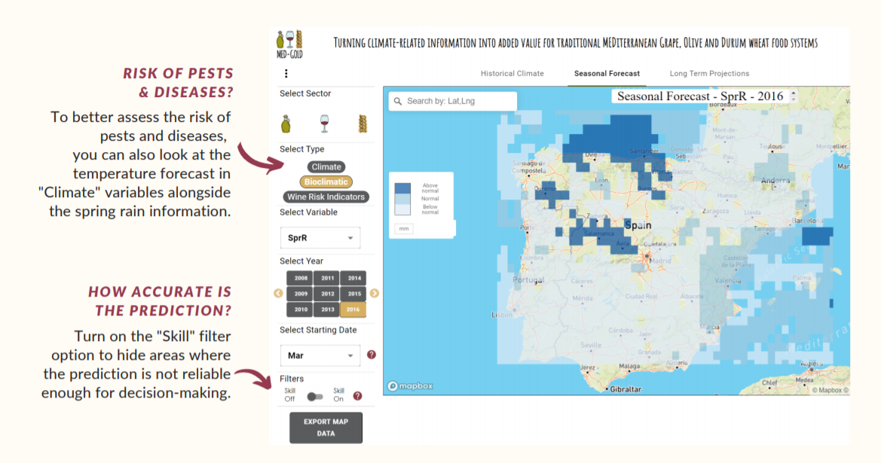
You can export the map and graph, discuss with the procurement department, and plan the purchase of plant protection products based on the seasonal forecasts and the prediction accuracy in your area in the past

Slide 25
Am I going to be affected by pests?
Climate Service: Seasonal forecast in the platform
Friendly ICT platform
Improved and enhanced Climate Model
MEDGold users in the wine sector (SOGRAPE)
Is this spring going to be rainy or warm?
Customizable on demand
How much stock plants I need to buy?
Lean Canvas model
Money saved by your client
Visits and interviews in order to gather customer needs
Number of clients
Estimation from past years
“The information Age applied to your field…”
Wine Sector
Cost of the ICT
Storage, research, upgrade…
Cost of the marketing (finding new clients)
Price paid per customer
Training workshops

Slide 26
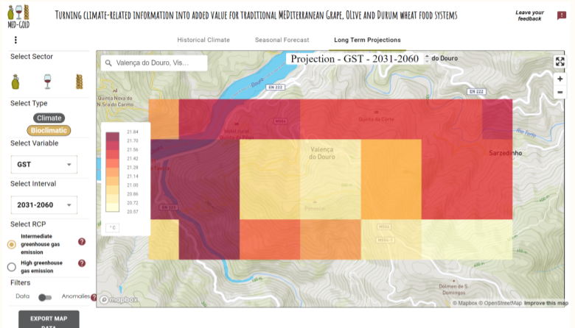
First, select the "Long-term Projections" timescale.
In the location box, type in the name of the closest village to the vineyard Select the growing season temperature (GST) from the bioclimatic indicators.
Then, select the time frame for which to see future temperatures (e.g. 2031-2060)
Finally, choose an emission scenario (e.g. intermediate greenhouse gas emissions)

Slide 27
In this situation, the average growing season temperature in the area is expected to be above 20 degrees Celsius, which is outside the range of your grape variety. You can export the data from the map as a .csv table and use Excel to find other geographical areas with more suitable temperatures to produce your top-selling wine in the future.

Slide 28
Lean Canvas model

Slide 29
Prototype

Slide 30
MVP

Slide 31
Let’s define a prototype MVP

Slide 32
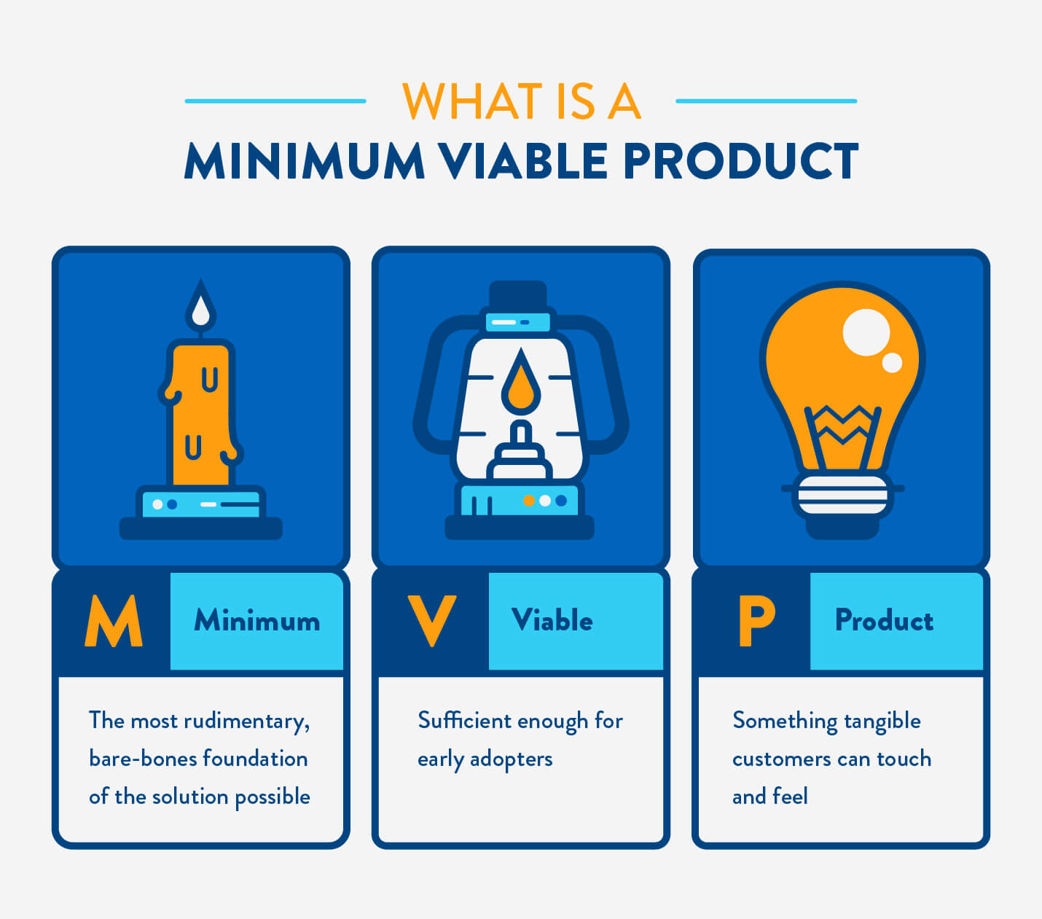

Slide 33
Minimum + Viable
Good Product for Start-ups
MINIMUM
VIABLE
Products built by companies better-financed than you
Products that nobody wants to use

Slide 34
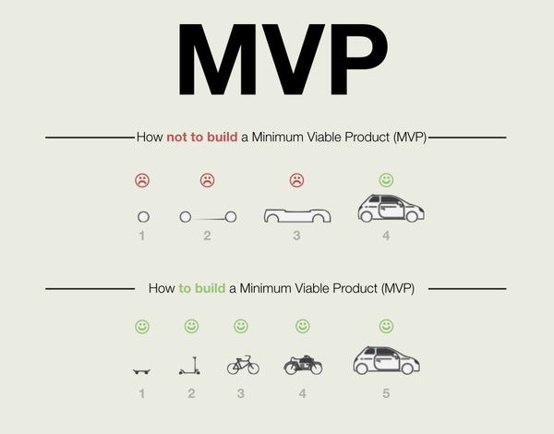

Slide 35
THANKS!!!
Antonio Tabasco /
GMV Remote Sensing and Geospatial Services Division manager

